Slide 1

Visualizing Search Results:
Some Alternatives To Query-Document Similarity

Slide 2
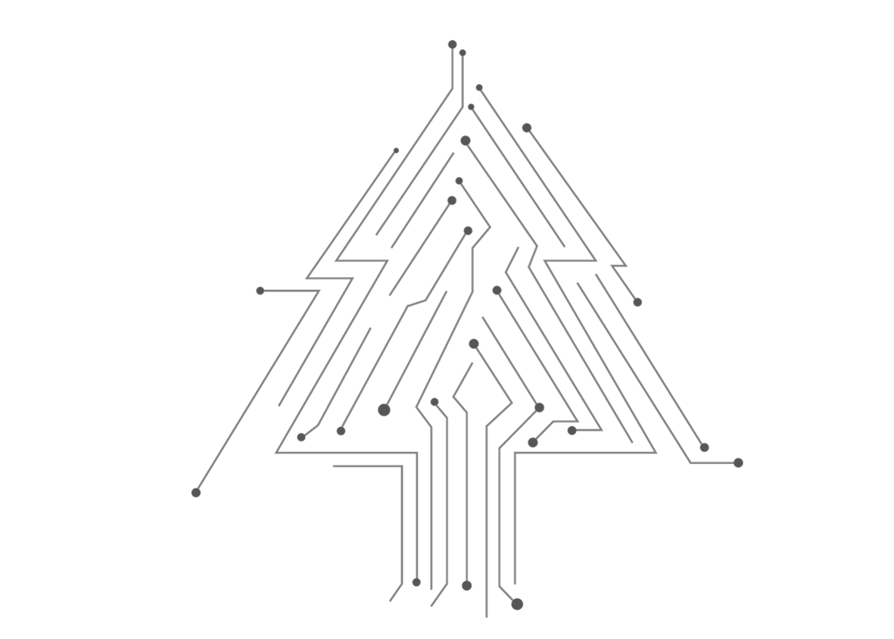
01
Introduction
02
Brief View of Paper
03
Design Details
04
Algorithms
05
Summary

Slide 3
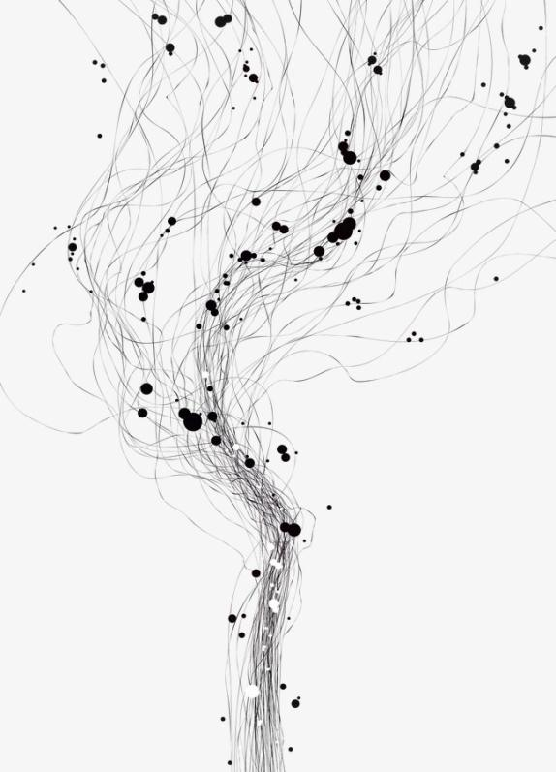
Introduction

Slide 4
Introduction
Envision:
A multimedia digital library of computer science literature
Used to display and visualize the search results of the query
Background:
Enhance computer science students’ search ability
Because authors think their bad habits in study will not prepare them for lifelong learning in their profession.

Slide 5
Introduction
Resources:
Bibliographic records from ACM Guide to Computing Literature
Review articles from Computing Reviews
Full-texts supplied by the typesetter of the Transactions
Full-texts keyed in of Communications
And some videos and animations

Slide 6
Brief View of Paper

Slide 7
Brief View
Part1
Part2
Part3
Part4
Part5
Introduced the basic information about Envision and compared it with several function-like software.
Mainly described why and how authors decided to develop additional system of information visualization.
The most important part. It showed the design for Visualization system and examples of different situations, and some explanation.
Described the result of usability test among participants in the area of computer science
Summarized the status of Envision at that time, authors’ expectation and brief solutions to some limitations.

Slide 8
Design Details

Slide 9
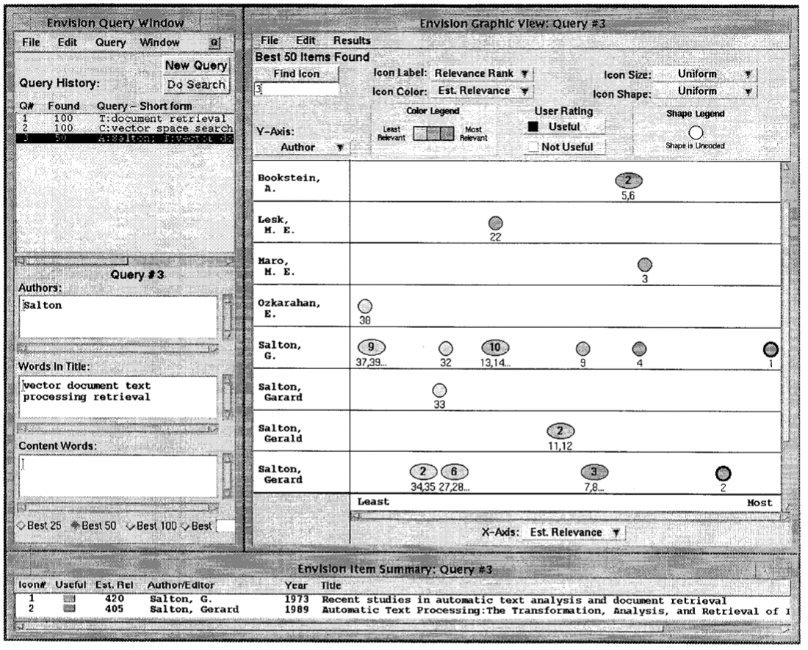
Design Details-User Interface
Layout option
Select the author
Select word in title
Select words in content
Number of items shown

Slide 10
Design Details-Visualization Choices

Slide 11
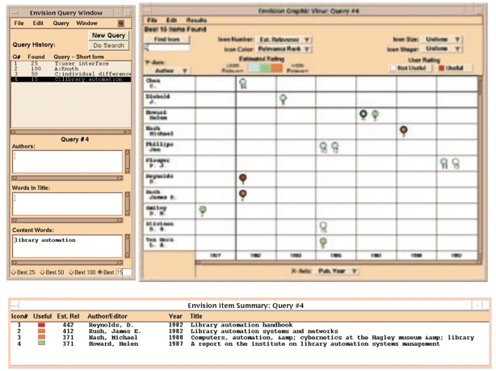
Design Details-Visualization Choices

Slide 12
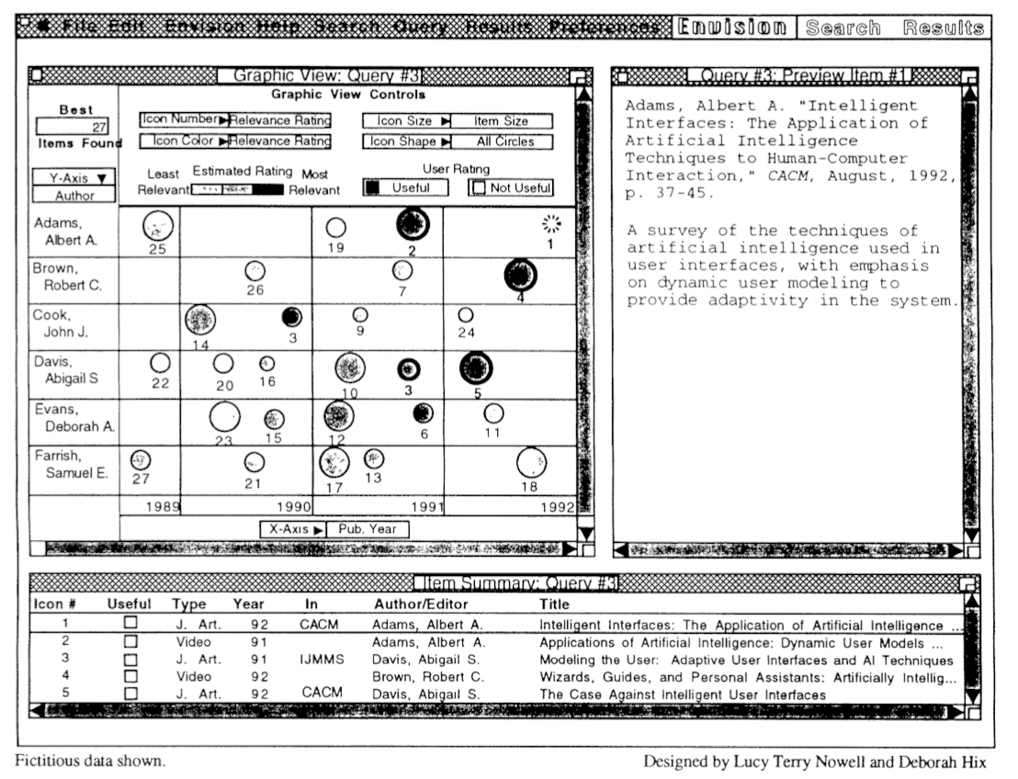
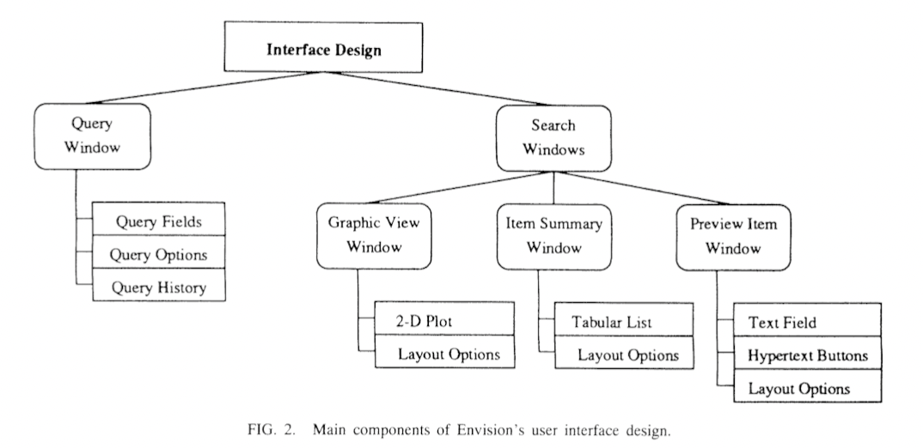
Design Details-Further Development

Slide 13
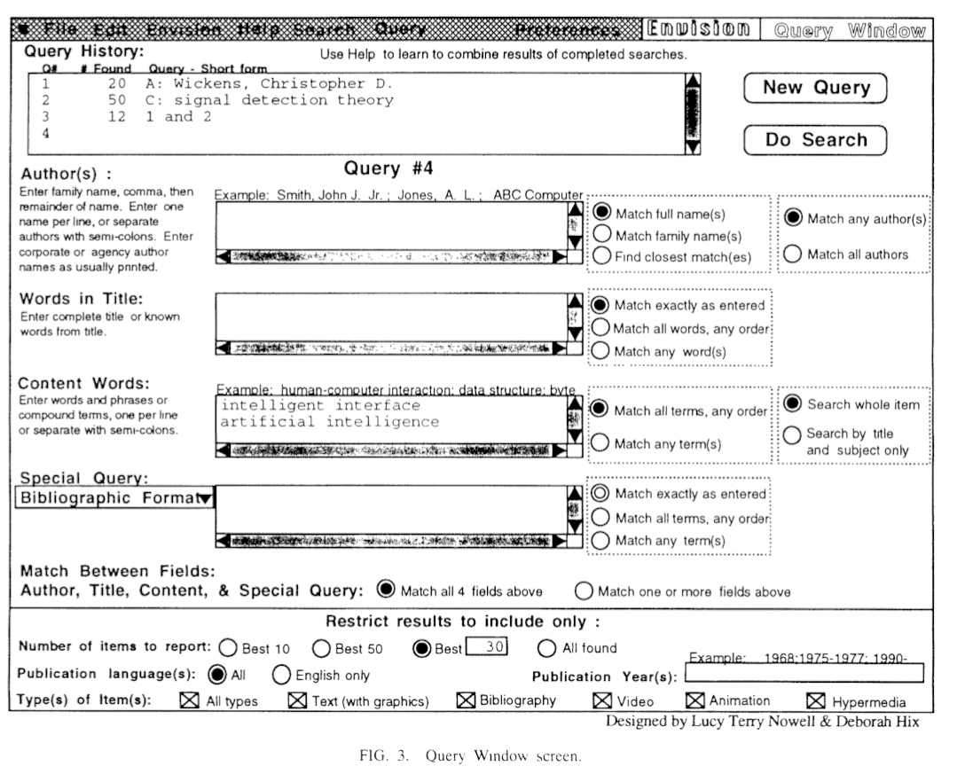
Design Details-Further Development

Slide 14
Algorithm

Slide 15
Design Algorithm
Query-document similarity computation algorithm
Graphic view layout algorithm

Slide 16
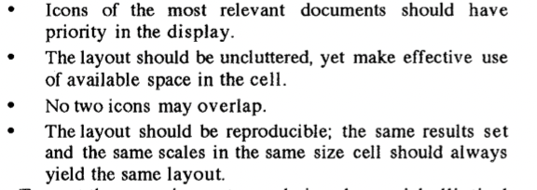
Design Algorithm
Principles:

Slide 17
Summary

Slide 18
Summary-Pros & Cons
Pros:
Shows a clear picture of Envision project
A very successful project of information visualization system in the early years.
Many latter publications have cited this paper as their inspiration
Cons:
Too old
Did not talk much about relevance computation algorithm
Result of test was not significant enough

Slide 19
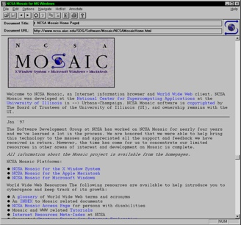
Summary-Pros & Cons

Slide 20
Summary-Pros & Cons
Pros:
Shows a clear picture of Envision project
A very successful project of information visualization system in the early years.
Many latter publications have cited this paper as their inspiration
Cons:
Too old
Did not talk much about relevance computation algorithm
Result of test was not significant enough

Slide 21
Reference
A Survey on Visual Approaches for Analyzing Scientific Literature and Patents
Envision- A User-Centered Database of Computer Science Literature
Envisioning Information
Graphical Encoding for Information Visualization- An Empirical Study
Query Composition- Why Does It Have to Be So Hard?
Similarity Preserving Snippet-Based Visualization of Web Search Results
Users, user interfaces, and objects- Envision, a digital library

Slide 22
Thanks

